Slide 1
Exploring RNN and Normal Modes

Slide 2
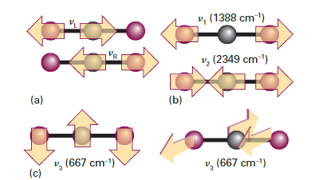
Normal modes
Normal modes are independent modes of vibration
Vibrate at a certain frequency
A vibration in a normal mode does not induce vibration in another mode
The motion of a system is a superposition of the normal modes
Number of modes
Linear: 3N-5
Non-linear: 3N-6
ISBN: 9780199609819

Slide 3
Normal modes
Convert forces into normal mode basis
Predict forces in the normal mode basis
Calculate new positions and convert them to a cartesian basis

Slide 4
Normal modes
Convert forces into normal mode basis
Uncertain of how to do this, ASE has a mode to calculate vibrations
https://wiki.fysik.dtu.dk/ase/ase/vibrations/modes.html
Force constant matrix
Predict forces in the normal mode basis
Same ARIMA model previously used?
Calculate new positions and convert them to a cartesian basis
Again not sure how to go from normal mode to cartesian

Slide 5
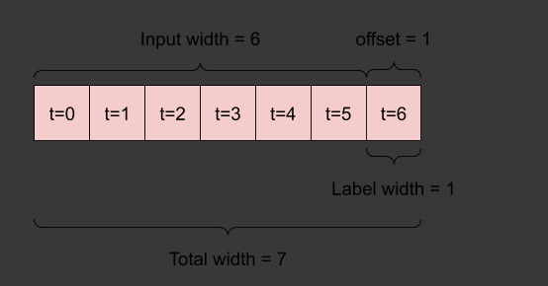
RNN
ML model well-suited to time-series
Takes windows of inputs as data
For us input would likely consist of forces plus descriptors
Label would be forces at the next time step
https://www.tensorflow.org/tutorials/structured_data/time_series

Slide 6
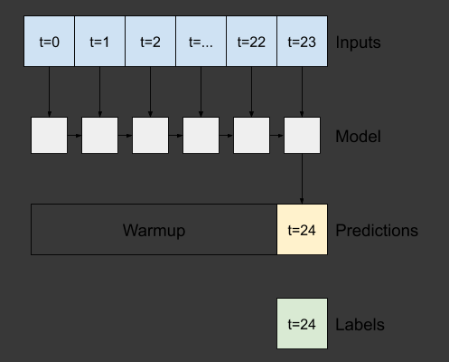
RNN
ML model well-suited to time-series
Takes windows of inputs as data
For us input would likely consist of forces plus descriptors
Label would be the forces at the next time step
RNN can use the output as input for the next step
LSTM
GRU
https://www.tensorflow.org/tutorials/structured_data/time_series

Slide 7
RNN
Train network on existing data for the molecule.
Train model on 500 time steps.
Afterwards apply the model to predict y steps with a window of inputs

Slide 8
RNN
Use a generally trained model that then retrains on the window it makes predictions on
Inpired by pre-trained CNN
The idea is that there is not much information in the force time-series outside the last 10 points
The general training will hopefully allow the model to see how descriptors affect the force
The model will then overtrain on the window making predictions on
Best case scenario it will serve as ARIMA + descriptors model
Like ARIMA model the RNN will almost only have information on the current window
No Idea if possible or sensible

